Slide 1
CS6000 F18 Introduction to LaTeX
Some content taken from Oetiker et al. “The Not So Short Introduction to LaTeX 2e”

Slide 2
Average Anatomy of a Thesis
6 Chapters, 2 Appendixes
14 Section
18 Subsections
196 Charts
32 Figures
48 Tables
95 cited works

Slide 3
Data for a Thesis
~ 40,000 raw data files
~ 8,000 processed data files
865 charts
41 tables
Charts and tables change when data changes!

Slide 4
Managing the Complexity
Scripts to process /gnerate data
Python, Shell scripts, awk, bc, grep, sed, wc, etc…
Non-interactive programs to create charts
Matplotlib, gnuplot, Matlab, latex
A document preparation system that:
Decomposes and compartmentalizes writing
Integrates with other tools
Automates formatting and numbering

Slide 5
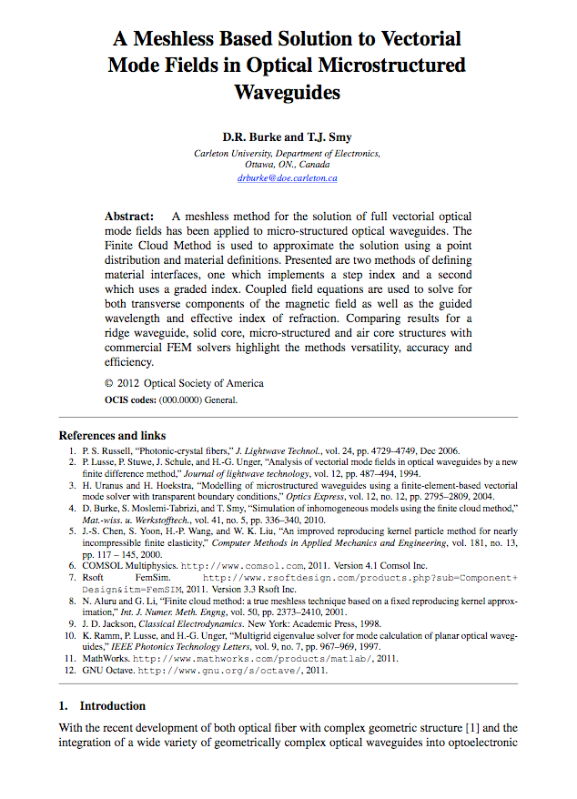
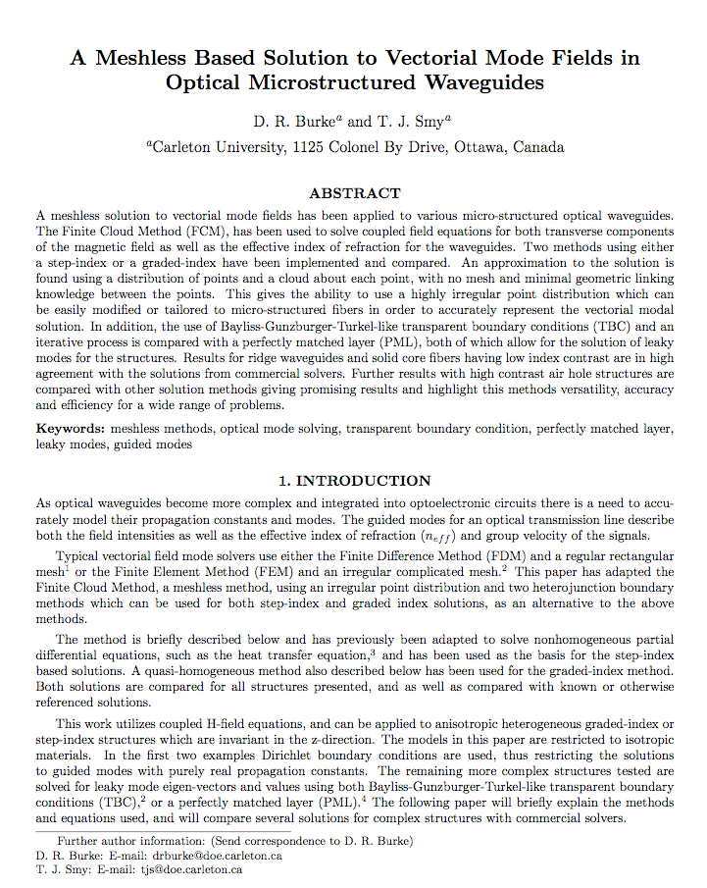
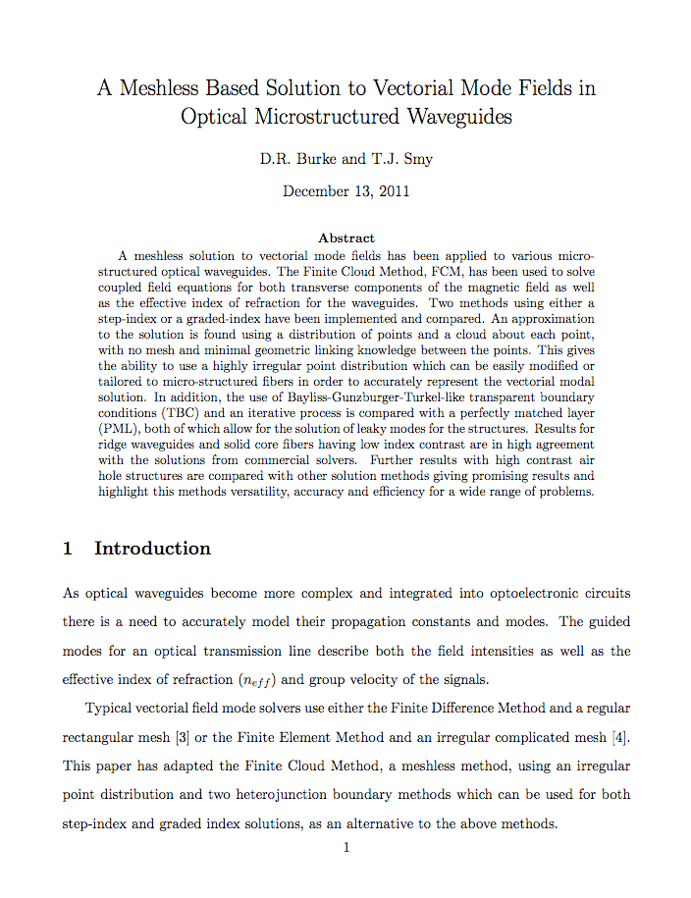
There exists alternatives to Word, one example is LaTeX - a typesetting language similar to C/HTML

Slide 6
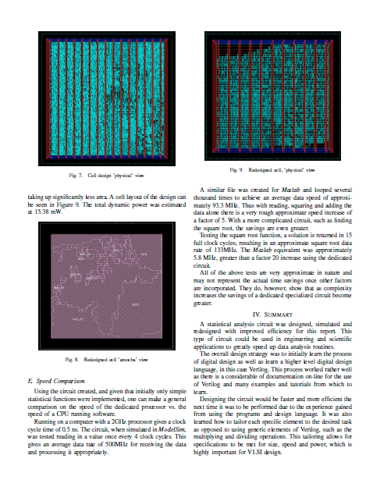
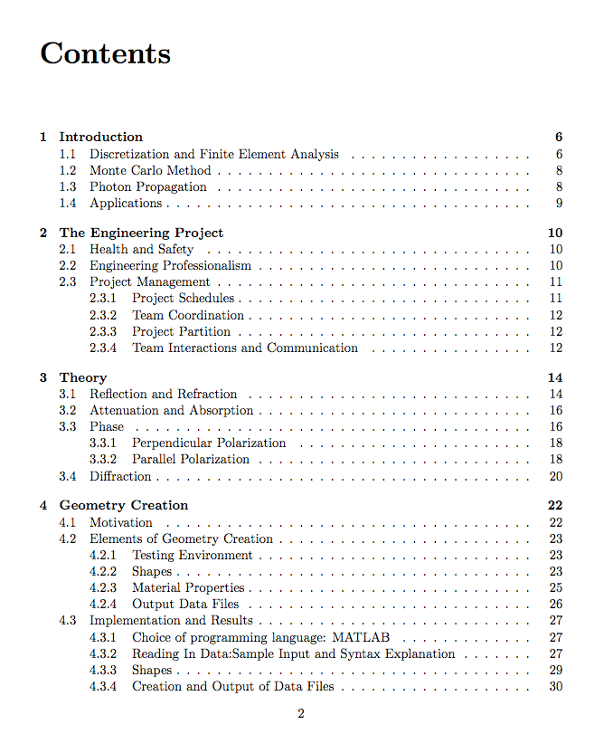
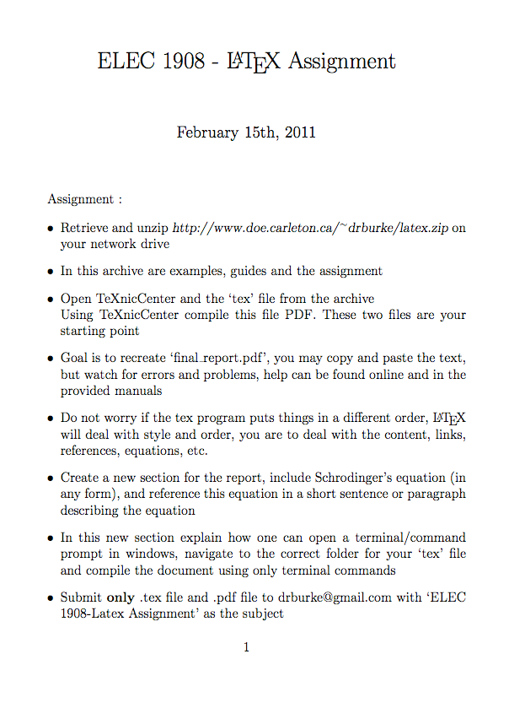
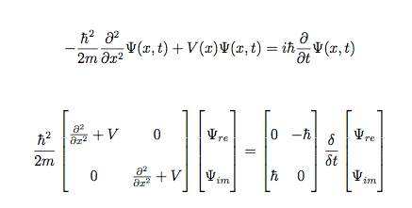
LaTeX can be used for papers, labs, word documents, assignments, presentations

Slide 7
Document Structure
Root
File
Local.bib
Intro.tex
Results.tex
Conc.tex
Fig1.pdf
Sec1.tex
Sec2.tex
matplotlib
gnuplot
script
Tab.tex
Fig2.pdf

Slide 8
Resources
https://ctan.org/ the Comprehensive TEX Archive Network (Good for packages/tools)
For TeX (with lots of latex as well) :
http://www.tug.org/
LaTex project page
http://www.latex-project.org/
Not so short introduction to LaTeX:
http://ctan.tug.org/tex-archive/info/lshort/english/lshort.pdf
Latex Video Tutorials
https://www.youtube.com/watch?v=SoDv0qhyysQ&list=PL1D4EAB31D3EBC449
Can read the LaTex source code (its written in TeX)
Google is your friend…

Slide 9
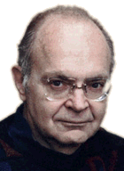
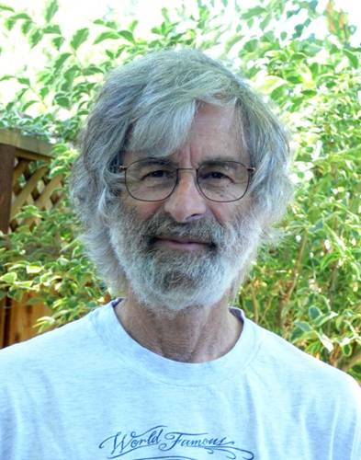
History
Late 1970s -> 1989: TeX by Don Knuth
Decent typesetting by the authors!
Same output now as in the future
Low level, but powerful
Frozen development
Starting early 1980s: LaTeX by Leslie Lamport
High level macros for/in TeX
Easy to use! Moderate/difficult to extend.
Current version is Latex2e

Slide 10
LaTeX as in “latex” or…?
Some say LAY-teck
Some say LAH-teck
Some say LAY-tech (as in “Bach”)
Some say LAY-tex
…
According to Wikipedia: Knuth says /tex/ (as in Bach)
Lamport says “whatever…”

Slide 11
Getting started…
All you need is:
LaTeX installation with appropriate interpreters
A .tex file (the document)
Can also have, (almost always do have):
External style files
TeX editors (more on this later)
BibTex

Slide 12
Installation
Linux
Typically comes with LaTeX or has it easily available in the standard repositories
“TeX Live”
Mac
http://www.tug.org/mactex/
Windows
http://www.tug.org/protext/
This will install MiKTeX, Ghostscript, and TeXnicCenter.
Extra packages
http://en.wikibooks.org/wiki/LaTeX/Packages/Installing_Extra_Packages

Slide 13
Online tools
Online tools supporting latex
https://www.overleaf.com/
(they bought https://www.sharelatex.com/)
latexlab.org (integrates with Google Docs)
http://quicklatex.com/ , codecogs.com
or http://Mathstools.com (If you must use word/PPT can get quick latex-based images. latter two can also help learn syntax as have GUI for generation)

Slide 14
Overleaf
Web and Browser based latex editor
Cloud based storage
Large number of templates
Collaborative document developement

Slide 15


Slide 16
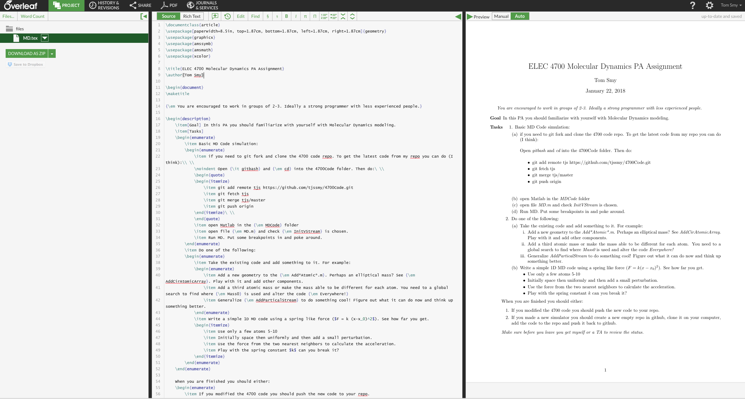

Slide 17
WHERE CAN I FIND IT ?
Linux – check documentation for the Latex source (suggested IDE: Kile)
Mac OS X – use MacTeX, or homebrew or macports to install as a package (suggested IDE: TeXShop)
Windows – MikTex or ProTeXt (suggested IDE: TexWorks or Texniccenter)
In the lab click on file and TexWorks should start up.

Slide 18
Making your first LaTeX documents
Start with a skeleton document
Write your text
Annotate the appropriate parts (math, etc)
Interpret through appropriate program
Fix errors or modify, and try again…
Older than but not unlike HTML or other markup languages
Interpret via the provided programs:
pdflatex -> PDF (older version latex -> DVI (dvi2ps or dvi2pdf)
Or built in features in your IDE.

Slide 19
LaTeX is written in structured macro markup , then compiled like a ‘C’ program
\documentclass[12pt]{article}%
\usepackage{amsmath}%
\usepackage{amsfonts}%
\usepackage{amssymb}%
\usepackage{graphicx}
\usepackage{setspace}
\usepackage{cite}
\usepackage{hyperref}
%-------------------------------------------
\begin{document}
\title{}
\author{Terry
\\ \emph{with} }
\date{\today}
\maketitle
\singlespacing
\begin{abstract}
\end{abstract}
\doublespacing
\section{Theory}
file.out
file.aux
file.log
file.pdf
compile

Slide 20
Structure
A basic document:
\documentclass[11pt, twocolumn]{article}
\usepackage{amsmath, graphicx}
\begin{document}
%document contents go here
\end{document}
Notice:
\begin and \end (these define “environments”)
{ } and [ ] around parameters to commands
Commands typically start with backslash
Commands “gobble” spaces.. spaces collapse to 1
% starts comment, goes to end of line

Slide 21
PACKAGES ?
Add functionality to your documents
Images
Equations
Links
Etc.

Slide 22
PACKAGES
\usepackage{amsmath}%
\usepackage{amsfonts}%
\usepackage{amssymb}%
\usepackage{graphicx}
\usepackage{setspace}
\usepackage{cite}
\usepackage{hyperref}

Slide 23
Formatting Text
Emphasis and size
\textbf{some bold text} \emph{some italic text} \underline{some underlined text}
{\large Some large text.} {\Large Larger text.} {\small Small.}
Spacing
Many spaces = one space
Use \\ for newline
Hit return twice for a new paragraph
\newpage
“Glue” effects layout.. can stretch or shrink
Quotes are done with `` and ‘ ‘ , not “
Add comments %comment text until end of line
Like any language, some characters are special. For example, \ $ { } % cannot be written alone. Use \\ or \$ or …

Slide 24
Organization
Indenting text as a quotation (an environment!)
\begin{quote}
A quote.
\end{quote}
Section headings
\section{an arbitrary name}
\subsection{an arbitrary name}
\subsubsection{an arbitrary name}

Slide 25
Lists
Done with an environment
\begin{enumerate}
\item some item in the list
\item another item in the list
\end{enumerate}
Replace enumerate with itemize for non-numbered
Various packages or commands to effect layout of lists

Slide 26
Images/Graphics
\usepackage{graphicx}
\includegraphics[height=50%,width=50%]{filename.png}
\includegraphics[width=.9\columnwidth]{filename.png}
\includegraphics[width=3.1in]{filename.png}
\includegraphics[attr1=val1, attr2=val2, ..., attrn=valn]{image.eps}
LaTeX explicitly supports EPS file format, as said in the documentation, but it also supports *.jpg, *.png, *.pdf

Slide 27
Boxes: Key Concept
All of tex/latex is based boxes, every char is a box.
The concept to understand is that the file needs an area to be displayed in.
This area is called the bounding box. If not in file (or raw image) can specify it with bb argument. Else uses file/paper type.
Example: \documentclass{article} \usepackage{graphicx} \begin{document} … \includegraphics[bb = 1 2 10 20, width = 4in]{file.eps} … \end{document}

Slide 28
Attributes
bb = XXX XXX XXX XXX Bounding box. The first two sets of points, represent the lower-left corner of graphic being the point in the text it was inserted, the second set of points are the upper right corner position.
width = xx Specify the preferred width of the imported image to xx.*
height = xx Specify the preferred height of the imported image to xx.*
keepaspectratio This can be set to either true or false. When true, it will scale the image according to both height and width, both will not distort the image, so that neither width or height are exceeded. Eg. keepaspectratio = true
scale = xx Scales the image by the desired scale factor. e.g, 0.5 to reduce by half, or 2 to double.
angle = xx This option can rotate the image by xx degrees (anti-clockwise)
trim=l b r t This option will crop the imported image by l from the left, b from the bottom, r from the right, and t from the top. Where l, b, r and t are lengths.
clip For the trim option to work, you must set clip=true
*Only specifying one of width/height will scale the image while keeping the aspect ratio.

Slide 29
Example
\documentclass{article}
\usepackage{graphicx}
\begin{document}
\begin{center}
\title{How to insert an image in LaTeX}
\fontsize{15pt}{22pt}\textbf{How to insert an image in LateX}
\end{center}
Well lets see how this works. What can you really do with this software, can we insert an image after a paragraph? Are we able to insert an image inline with the text. Are there other features to be had with inserting an image with LaTeX.
\par\bigskip
\includegraphics[bb = 0 0 100 150]{images.jpg}
\par
More text to see where it wraps to.
\end{document}

Slide 30
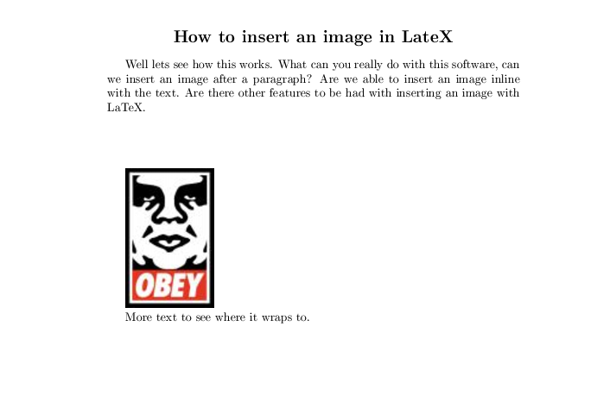
Example

Slide 31
Example
\documentclass{article}
\usepackage{graphicx}
\begin{document}
\begin{center}
\title{How to insert an image in LaTeX}
\fontsize{15pt}{22pt}\textbf{How to insert an image in LateX}
\end{center}
Well lets see how this works. What can you really do with this software, can we insert an image after a paragraph? Are we able to insert an image inline with the text. Are there other features to be had with inserting an image with LaTeX.
\par\bigskip
\includegraphics[bb = 0 125 100 150, trim = 0 0 50 150, clip = true]{images.jpg}
\par
More text to see where it wraps to.
\end{document}

Slide 32
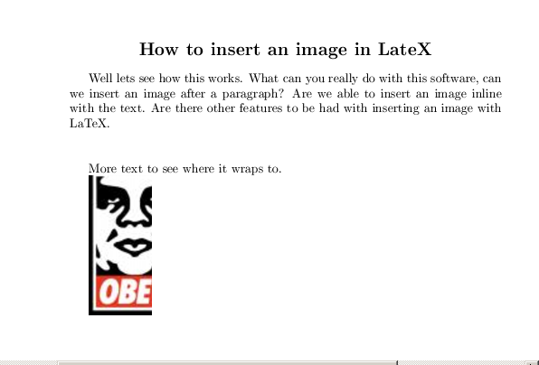
Example
But just insertgraphics is bad..

Slide 33
Figures
Latex has a powerful set of “Floats”, where it dose placement
\begin{figure}[th]
\centering
\includegraphics[width=8cm]{actorcritic}
\caption{Sutton's Actor-Critic method.}
\label{fig:actorcritic}
\end{figure}
\begin{figure}[h!]
\resizebox{\textwidth}{!}{\rotatebox{-90}{\includegraphics{modules}}}
\caption[Systems modules and messages.]{Flat layout of message passing between modules.}
\label{fig:modules}
\end{figure}

Slide 34
Latex treats figures as floating objects
Placement specifiers can be used
h place item here in the text
t place item at the top of a page
b place item at the bottom of a page
p place item on a special page containing only floats
! override other parameters even if (Latex thinks) the result looks awful.

Slide 35
Labels and references
Use labels and references to automatically insert reference numbers:
\subsection{The first subsection} \label{arbitrarylabel}
Some text.
\subsection{Next subsection}
The previous subsection was \ref{arbitrarylabel}.
And for equations:
\begin{equation}
E = mc^2 \label{einstein}
\end{equation}
Einstein is associated with Eq.~ \eqref{einstein}.

Slide 36
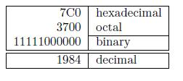
Tables
Table is nother “float” environment!, tabular is the actual layout
Tables are tricky and have a lot of options. An example:
\begin{tabular}{|r|l|}
\hline
7C0 & hexadecimal \\
3700 & octal \\ \cline{2-2}
11111000000 & binary \\
\hline \hline
1984 & decimal \\
\hline
\end{tabular}
|r|l| tells how to setup and align the columns. & sets the columns
See references for more details…

Slide 37
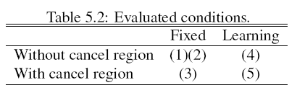
Tables
\begin{table}[ht]
\caption{Evaluated conditions.}
\centering
\begin{tabular}{l c c}
\hline\hline
& Fixed & Learning \\
\hline
Without cancel region & (1)(2) & (4) \\
With cancel region & (3) & (5) \\
\hline
\end{tabular}
\label{table:conditions}
\end{table}
Ideally generate tables from code so can update with any new run.

Slide 38
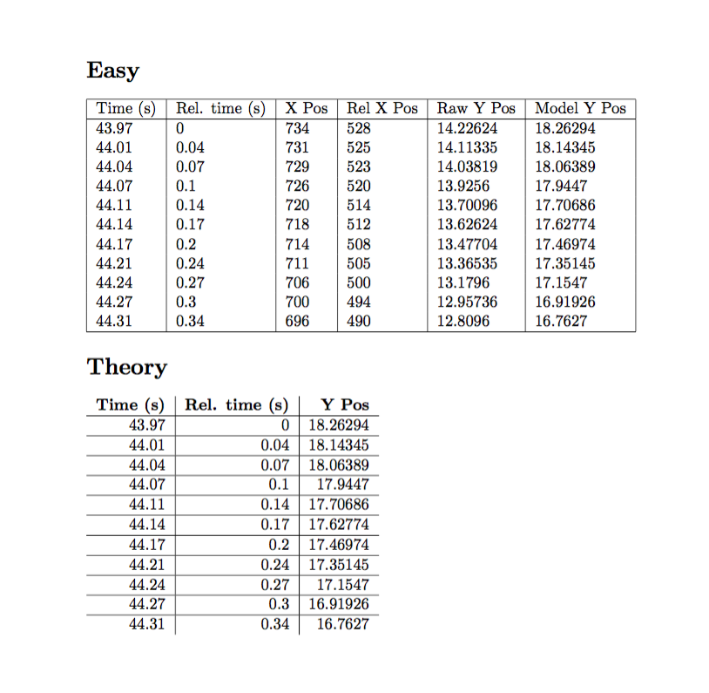
\documentclass{article}
\usepackage{csvsimple}
\begin{document}
\section*{Easy}
\csvautotabular{test.csv}
\section*{Theory}
\begin{tabular}{r|r|r}%
% specify table head
\bf Time (s) & \bf Rel. time (s)& \bf Y Pos
% use head of csv as column names
\csvreader{test.csv}{}
% specify selected coloumns here
{\\\hline\csvcoli&\csvcolii&\csvcolvi}
\end{tabular}
\end{document}
Can also use http://www.tablesgenerator.com/

Slide 39
Math Mode
“Math mode” formats formal notation.
3+1 in normal mode
will not look like
3+1 in math mode
To enter inline math mode, use $ and $
When $x = 3$, $f(x,y)$ reduces to $y^2+16$.
For standalone math lines, use \[ and \]
The equation can be expressed as follows:
\[ f(x) = x^2 + 4x + 3 = (x+1)(x+3) \]
or
\begin{equation}
f(x) = x^2 + 4x + 3 = (x+1)(x+3)
\end{equation}

Slide 40
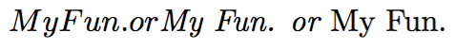
Math Mode
White space is typically ignored
$f(x) = g(x)$ will be the same as $f( x )= g ( x )$
Math eats spaces, many symbols contain natural spacing for other uses can use specialized spacing commands \; \, \
For text in math mode, use \textit{} or \textrm
$My Fun. or \textit{My Fun. or } \textrm{My Fun.}$
Most math is built in. But the amsmath package predefines more. Just use the package
\usepackage{amsmath}

Slide 41
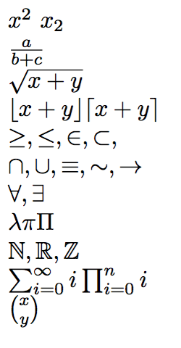
Math Symbols, etc
Subscript and superscripts: x^2 x_2
Fractions: \frac{a}{b+c}
Radical: \sqrt{x + y}
Floor and ceiling: \lfloor x + y \rfloor \lceil x + y \rceil
Operators and relations: \ge, \le, \in, \subset,
\cap, \cup, \equiv, \sim, \rightarrow
\forall, \exists
Greek letters: \lambda \pi \PI
Sets N, R, Z in amssymb: \mathbb{N}
\sum_{i=0}^{\infty} i \prod_{i = 0}^{n} i
Binomial coefficient: {x \choose y}
And much more! See:
http://wwhttp://web.ift.uib.no/Teori/KURS/WRK/TeX/symALL.html

Slide 48
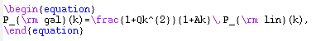
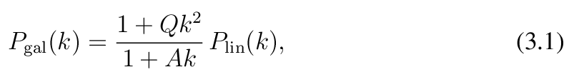
Equations: Example 1
You type:
You get:

Slide 49
Lists of equations
Aligning lists of equations is tricky (similar to tables)
eqnarray uses & alignment hooks into the equations
Don’t need to use $ $ or \[ \]. Already in math mode.
\begin{eqnarray}
f(x,y) &=& x + y \\
&=& 4x - 3x + y \\
&=& y (4 \frac{x}{y} - 3 \frac{x}{y} + 1)
\end{eqnarray}
Use eqnarray* to suppress numbering

Slide 50
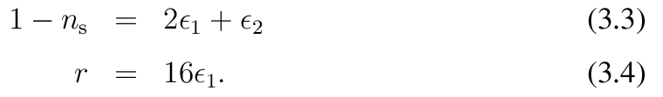
Equations: Example 2
Refer to it as \ref{e:3}
You type:
\begin{eqnarray}
1 – n_{\rm s} & = & 2 \epsilon_1 + \epsilon_2 \label{e:3}
r & = & 16 \epsilon_1 \label{eq4}
\end{eqnarray}
You get:

Slide 51
Algorithms
\usepackage[option]{algorithm2e}
http://www.ctan.org/tex-archive/macros/latex/contrib/algorithm2e/algorithm2e.pdf
(there are many other packages too)

Slide 52
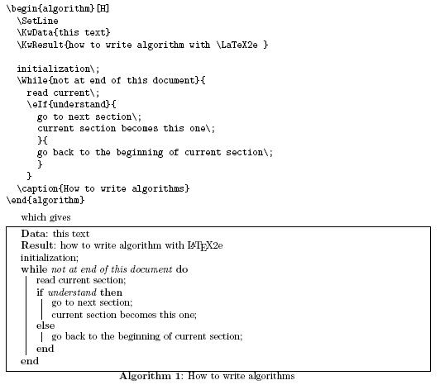

Slide 53
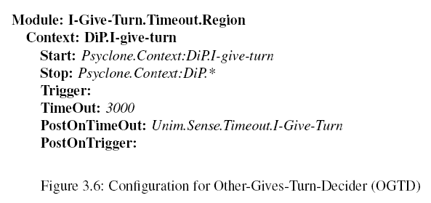
Algorithms
\begin{algorithm}
\dontprintsemicolon
\KwSty{Module: I-Give-Turn.Timeout.Region}
\;
\Indp
\KwSty{Context: DiP.I-give-turn}
\;
\Indp
\KwSty{Start: }
\ArgSty{Psyclone.Context:DiP.I-give-turn}
\;
\KwSty{Stop: }
\ArgSty{Psyclone.Context:DiP.*}
\;
\KwSty{Trigger: }
\;
\KwSty{TimeOut:}
\ArgSty{3000}
\;
\KwSty{PostOnTimeOut:}
\ArgSty{Unim.Sense.Timeout.I-Give-Turn}
\;
\KwSty{PostOnTrigger:}
\;
\BlankLine
\BlankLine
\caption{Configuration for I-Give-Turn Timeout Region}
\label{alg:regionIGT}
\end{algorithm}

Slide 54
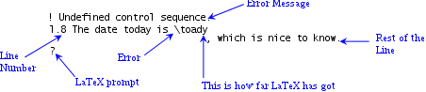
Debugging Latex problems
Note the line number (and file) and look to see if you can understand what went wrong. Check for “typos” as in the above
If not, Google is your friend, ask the exact error message.
http://tex.stackexchange.com/ has a lot of answers..
Package mismatches can be difficult so if you post asking question, explain what system you are n and what packages.

Slide 55
Simple macros
\newcommand{\myname}{MySystemName}
\def\long\longcomment#1{}
\newcommand{\bt}[1]{\textbf{#1}} \bt{if}
\newcommand{\vfrac}[2]{\ensuremath{\frac{#1}{#2}}}
\vfrac{a}{b}
%raw tex macro
\def\long\longcomment#1{}

Slide 56
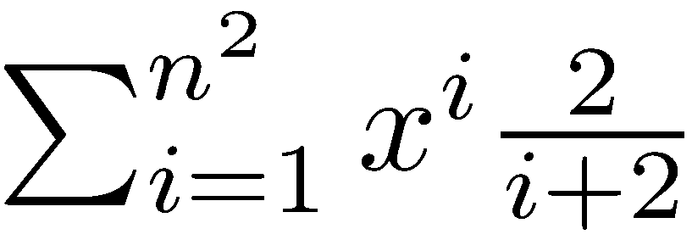
LaTeX in PowerPoint
TeXPoint – A LaTeX add-on for ppt and word
http://texpoint.necula.org/ ($)
TeXclip – LaTeX to image (there are many ~tools)
http://maru.bonyari.jp/texclip/texclip.php
Full Latex instead of PPT.)
Beamer slides using LaTeX
http://bitbucket.org/rivanvx/beamer/wiki/Home

Slide 57
And more…
Fonts, spacing, margins, bibliographies,
footnotes, book formatting, chapters, …
LaTeX is powerful!
See resources page and google around for help…

Slide 58
Referencing in BiBtex/ LaTex

Slide 59
Making references directly in LaTeX (fish.tex)
\documentclass{article}
\begin{document}
\emph{My mother} is a \underline{fish} \cite{WF}.
\begin{thebibliography}{99}
\bibitem{WF}
William Falkner, \emph{As I Lay Dying}
\end{thebibliography}
\end{document}

Slide 60
Compiling the ‘tex’ file - program reads through your file ONCE
??
See equation \eqref{simpleMath}.
\begin{equation}
1+2=3 \label{simpleMath}
\end{equation}
1
file.aux
Adds ‘simpleMath’

Slide 61
Compiling the ‘tex’ file - program reads through your file ONCE
Found it !
See equation \eqref{simpleMath}.
\begin{equation}
1+2=3 \label{simpleMath}
\end{equation}
file.aux
2
Adds ‘simpleMath’

Slide 62
Need to compile the document twice/thrice
Because we are using symbolic references, e.g., \cite{WF},
a second pass is necessary
The second pass will resolve references but can change pages.. So might need 3 passes
Personally I recommend using Make
Our standard paper makefile
all:
pdflatex -interaction=nonstopmode -synctex=1 paper.tex
bibtex paper
pdflatex -interaction=nonstopmode -synctex=1 paper.tex
pdflatex -interaction=nonstopmode -synctex=1 paper.tex
clean:
rm paper.pdf *.aux *.bbl *.blg *.log

Slide 63
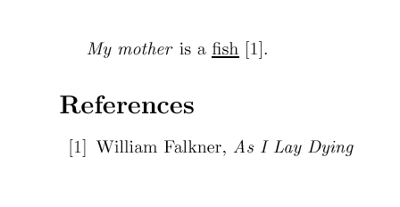
\documentclass{article}
\begin{document}
\emph{My mother} is a \underline{fish} \cite{WF}.
\begin{thebibliography}{99}
\bibitem{WF}
William Falkner, \emph{As I Lay Dying}
\end{thebibliography}
\end{document}

Slide 64
Problem with “raw bibilogrophy” or BBL method
User is burdened with deciding how to format article titles, journal names, proceeding references
Difficult to reuse references in other documents

Slide 65
Quick BibTex Tutorial

Slide 66
BibTex Tutorial
Why do you want to learn BibTex?
Nuts and Bolts of BibTex
Examples
BibTeX is…
A plain-text file format and a program designed to work with LaTeX
bibliographical information (author name, journal title, date, etc) stored in the file
incorporates BibTeX file (.bib) into LaTeX documents

Slide 67
Why you want to learn BibTex
Complements LaTeX documents by managing bibliography and references
Minimizes the drudgery of formatting, numbering, and referencing
Disadvantage:
Steep Learning Curve if you start from sratch
but plenty of tools/source make it easy to use

Slide 68
Sample Bibliographic Entry
@article{ Hemmendinger07,
author = {David Hemmendinger},
title = {The ACM and IEEE-CS guidelines for undergraduate CS education},
journal = {Commun. ACM},
volume = {50},
number = {5},
year = {2007},
issn = {0001-0782},
pages = {46--53},
doi = {http://doi.acm.org/10.1145/1230819.1230838},
publisher = {ACM},
address = {New York, NY, USA},
}
@article lets BibTeX know that the bibliographical entry is an article.
Other Types:
book
phdthesis
unpublished
misc
and others
Hemmendinger07 identifies the entry – used when citing it in a LaTeX document.

Slide 69
The BibTex Process
Create a BibTex file with Reference entries (or get from Zotero etc.. But be careful about Bad entries from google scholar)
Get a *.bst file (bibliographic style file)
“Compile” or “Build” your LaTeX document to create an *.aux file
Run BibTeX on your LaTeX file
Run LaTeX twice on your updated file
View the dvi or pdf file

Slide 70
Types of Documents BibTex can handle
ARTICLE
BOOK
BOOKLET
INBOOK
INCOLLECTION
INPROCEEDINGS
MANUAL
MISC
PHDTHESIS
PROCEEDINGS
TECHREPORT
UNPUBLISHED

Slide 71
Each Document type can have the following entries
address
author
booktitle
chapter
crossref
edition
editor
howpublished
institution
journal
key
language
month
note
number
organization
pages
publisher
school
series
title
type=“Ph.D. dissertation”
volume
year

Slide 72
Sample BibTex Book Entry (mybib.bib)
@BOOK{Press,
author="W.H. Press",
title="Numerical Recipes in C: The Art of Scientific Computing",
publisher="Cambridge University Press",
year=1992,
}

Slide 73
Sample BibTex: Article Entry
@ARTICLE{Vodacek,
author="Anthony Vodacek and F.E. Hoge and R.N. Swift and J.K. Yungel and E.T. Peltzer and N.V. Blough",
title="The use of in situ and airborne fluorescence measurements to determine {UV} absorption coefficients and {DOC} concentrations in surface waters",
journal="Limnology and Oceanography",
volume=40,
number=2,
year=1995,
pages="411--415",
}
% article is the most commonly abused type If you get one from somewhere check if its valid

Slide 74
Sample BibTex Technical Report Entry
@TECHREPORT{Berk,
author="Lex A. Berk and L.S. Bernstein and D.C. Robertson",
title="MODTRAN: a moderate resolution model for LOWTRAN 7",
number="GL-TR-89-0122",
institution="Spectral Science",
address = "Burlington, MA",
year = 1989
}

Slide 75
Sample BibTex Ph.D. Dissertation Entry
@PHDTHESIS{Kuo,
author="Jan-Tai Kuo",
title="The Influence of Hydrodynamic Transport on Phytoplankton Dynamics in Homogeneous Lakes",
school="Cornell University",
address="Ithaca, NY",
year=1981,
}

Slide 76
Sample BibTex Master’s Thesis Entry
@MASTERSTHESIS{Knobelspiesse,
author="Kirk D. Knobelspiesse",
title="Atmospheric Compensation for SeaWIFS Images of Lake Superior Utilizing Spatial Information",
school="Rochester Institute of Technology",
address="Rochester, NY",
month=Sep,
year=2000,
}

Slide 77
Sample BibTex Proceedings Entry
@INPROCEEDINGS{Stoermer,
author="E.F. Stoermer",
title="Nearshore phytoplankton populations in the Grand Haven, Michigan vicinity during thermal bar conditions",
booktitle="Proceedings of the 11th Conference on Great Lakes Research",
pages="137--150",
year=1968,
}

Slide 78
Different Formatting Styles
To invoke a particular style, go to
http://www.ctan.org
Document styles are defined in *.sty files
mla.sty
bmsplain.sty
Bibliography styles are defined in *.bst files
mla.bst
amsplain.bst
ieee.bst

Slide 79
To invoke these styles in your document
Copy them to your current working directory with your LaTeX and BibTex document
Edit your LaTeX file to appropriately reference these style guides

Slide 80
Sample LaTeX document listing Bibliography in MLA Style (text.tex)
\documentclass{report}
\usepackage{mla}
\begin{document}
\bibliographystyle{mla}
\bibliography{mybib}
\nocite{*}
\end{document}

Slide 81
Commands to Build and View Document
To generate pdf
% pdflatex test.tex
% bibtex test
% pdflatex test.tex
% pdflatex test.tex
%

Slide 82
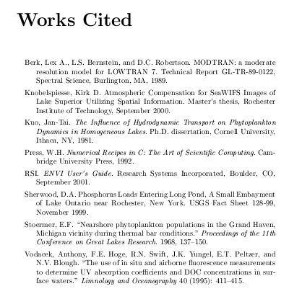

Slide 83
Sample LaTeX document listing Bibliography in AMS Style (test2.tex)
\documentclass{report}
\begin{document}
\bibliographystyle{amsplain}
\bibliography{mybib}
\nocite{*}
\end{document}

Slide 84
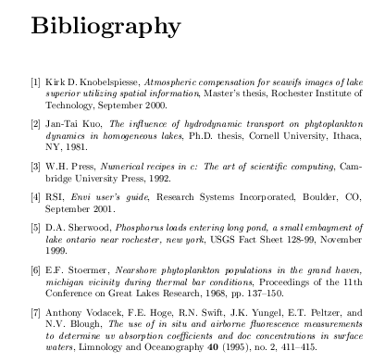

Slide 85
To include only cited articles we remove the \nocite{*} command
\documentclass{report}
\begin{document}
We want to get the documents \cite{RSI} and \cite{Kuo} for our collection
\bibliographystyle{amsplain}
\bibliography{mybib}
\end{document}

Slide 86
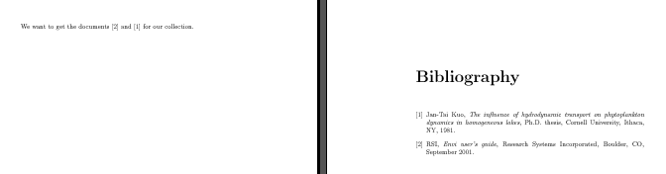

Slide 87
Cross-referencing in Proceedings
@PROCEEDINGS{Narayanan,
editor="Ram Mohan Narayanan and James E. Kalshoven, Jr.",
title="Advances in Laser Remote Sensing for Terrestrial and Oceanographic Applications",
booktitle="Proceeding of SPIE",
publisher="SPIE",
volume=3059,
year=1997,
}

Slide 88
Article in Proceedings
@INPROCEEDINGS{Ulrich,
author="B.L. Ulrich and P. Lacovara and S.E. Moran and M.J. DeWeert",
title="Recent results in imaging lidar",
crossref="Narayanan",
pages="95--108",
}

Slide 89
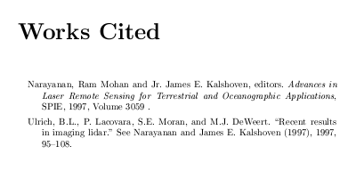

Slide 90
Use a reference management tool!
article
article
article
article
Your article
citations
book
Zotero
book
conference paper
reference list/bibliography
conference paper
conference paper
Notes:
90

Slide 91
Bigger documents/Better team work
Latex support “include/input” which can improve workflow
\input{introduction}
\input{related}
\input{approach}
\input{experiments}
\input{discussion}
\input{conclusion}

Slide 92
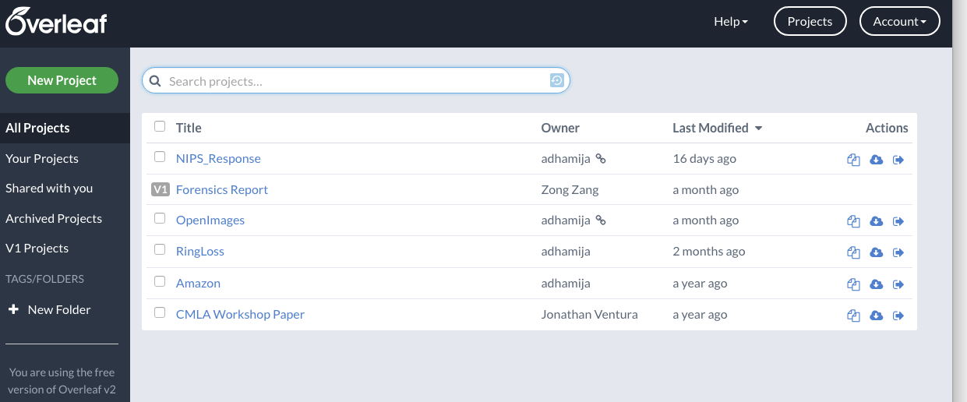
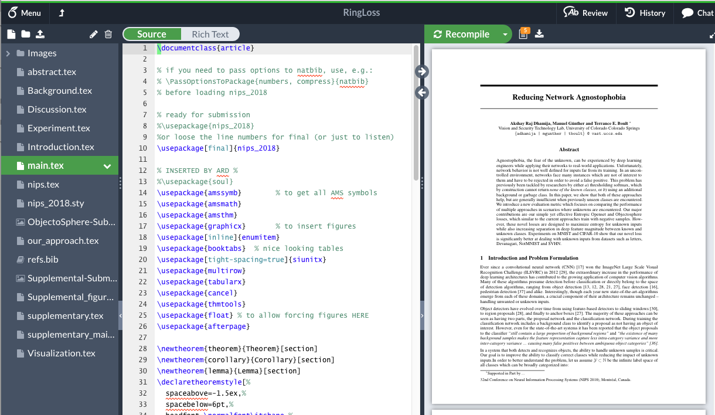
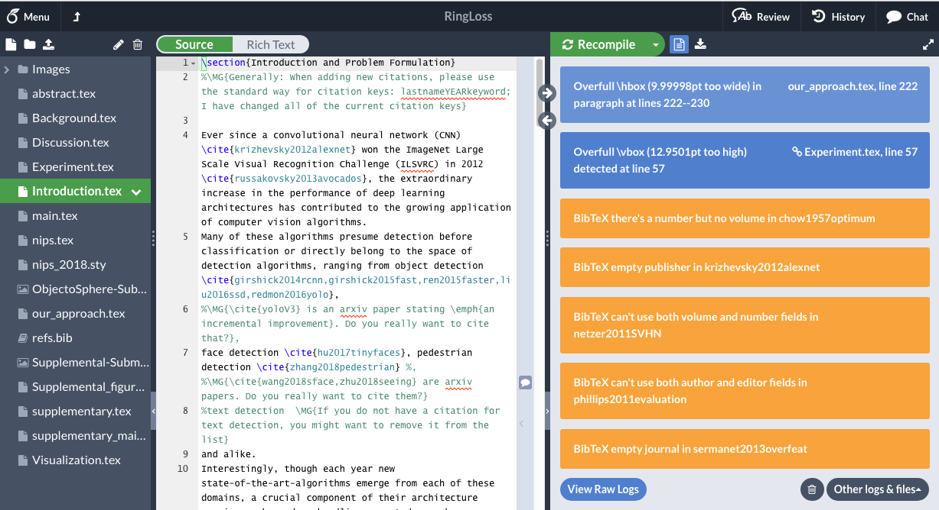

Slide 93
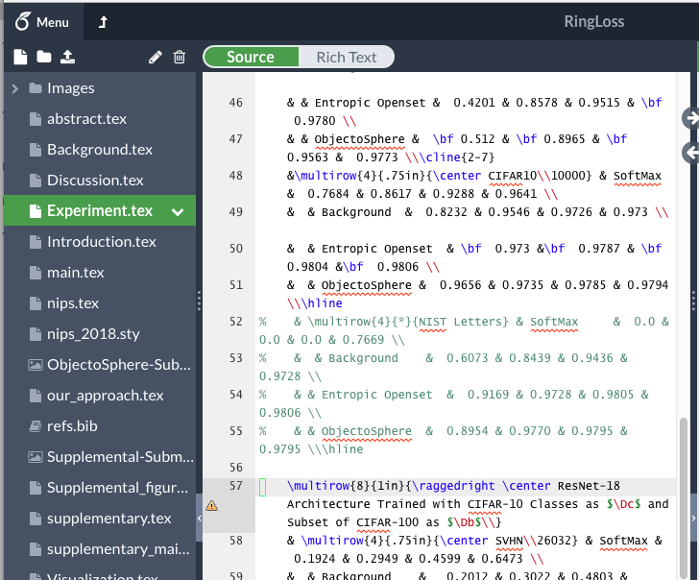
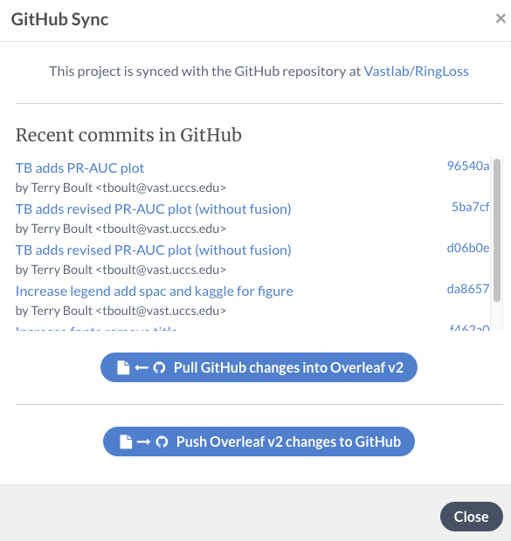
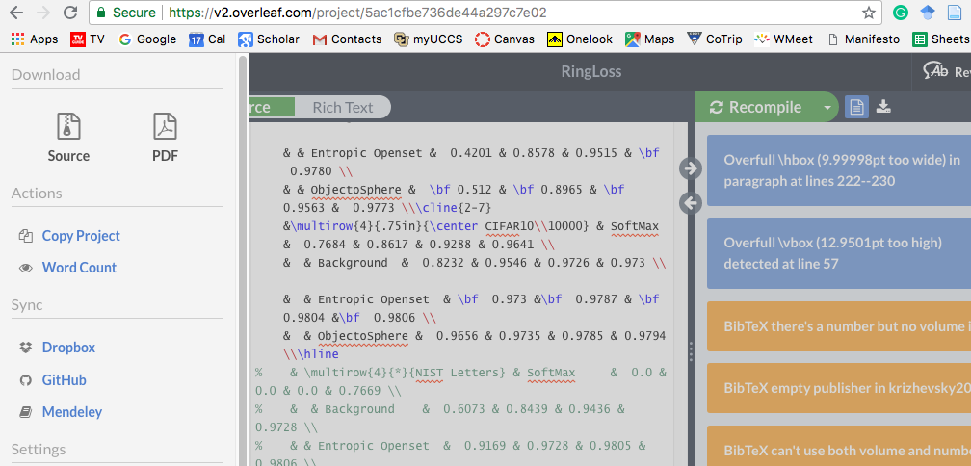
Overleaf and git

Slide 94
Resources
For TeX (with lots of latex as well) :
http://www.tug.org/
LaTex project page
http://www.latex-project.org/
Not so short introduction to LaTeX:
http://ctan.tug.org/tex-archive/info/lshort/english/lshort.pdf
Latex Video Tutorials
https://www.youtube.com/watch?v=SoDv0qhyysQ&list=PL1D4EAB31D3EBC449
Can read the LaTex source code (its written in TeX)
Google is your friend…

Slide 95


Slide 96
Reference management tools
Tools that help scholars to create and manage their lists of references for research projects.
Most tools are designed to organize citations into specific formats for the preparation of manuscripts and bibliographies.
Many search tools provide ways to download references into reference management tools.

Slide 97






Software options
Free
Subscription

Slide 98

Zotero
Zotero is a free (open source) reference management tool, that is available as an add-on for the Firefox web browser.
Standalone version for Chrome, Safari and Firefox browsers
To download and install Zotero go to: http://www.zotero.org

Slide 99
Zotero functionality
Zotero recognizes bibliographic information on books, journal articles, and other resources from websites and databases and extracts metadata from these sources.
Store related PDFs, files, images, and links in your library
Create a bibliography in Word or OpenOffice or export bib file for latex.
Publish shared libraries for your organization, class, or research group

Slide 100
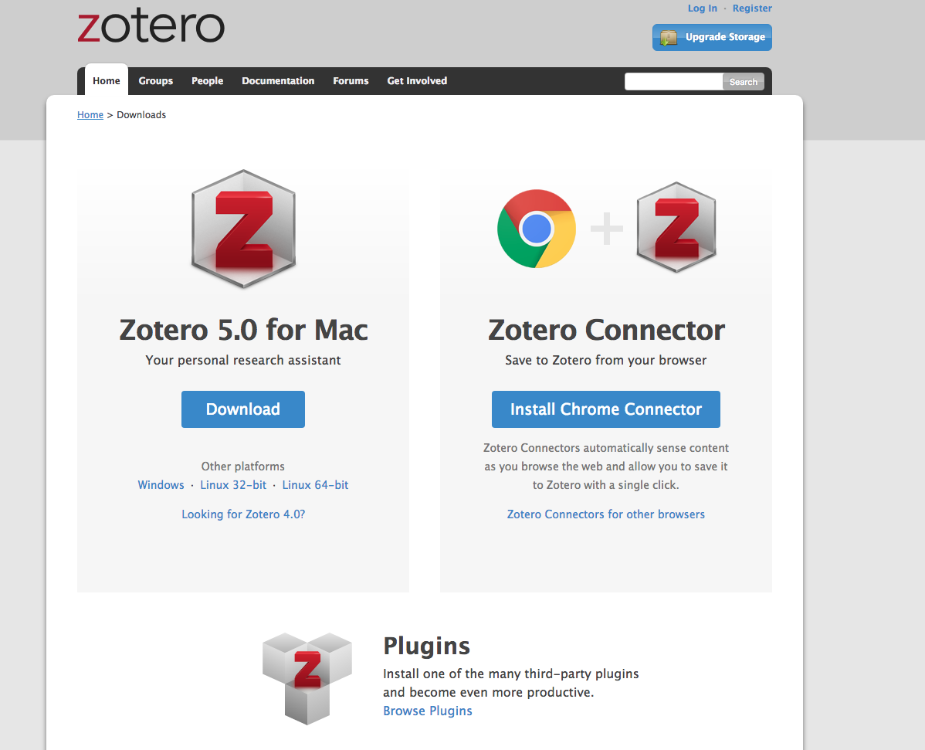
Note that there are Download options: Zotero/Firefox and Zotero Standalone version for Firefox, Chrome and Safari.

Slide 101
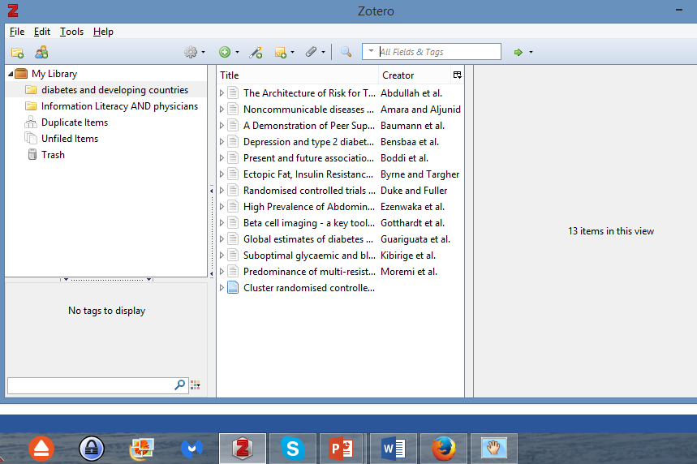
Open the Standalone version by clicking on the icon that, for this computer, is listed on the bottom taskbar.

Slide 102
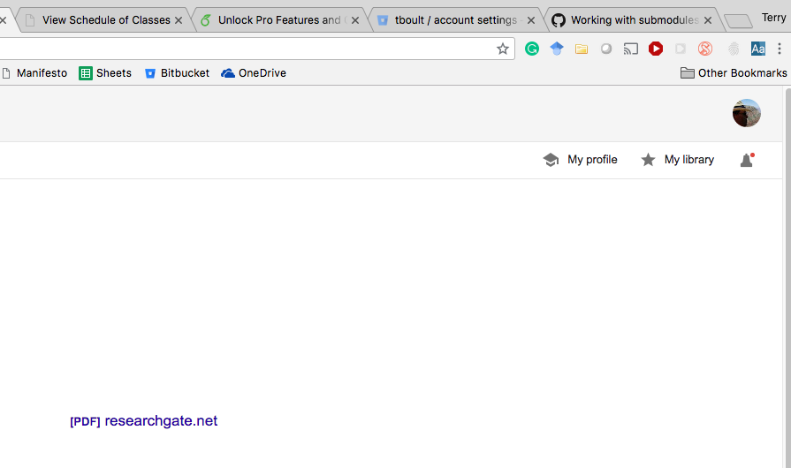
Zotero has been loaded and is accessible by clicking on the folder in chrome toolbar.
Registering for Zotero is optional.

Slide 103
Adding citations to Zotero
You can add citations to your library in several ways:
Manually enter citation information
Import citation information for a single item
Import citation information for multiple items
Automatically cite web pages
Add an item by identifier (ISBN, DOI or PMID)

Slide 104
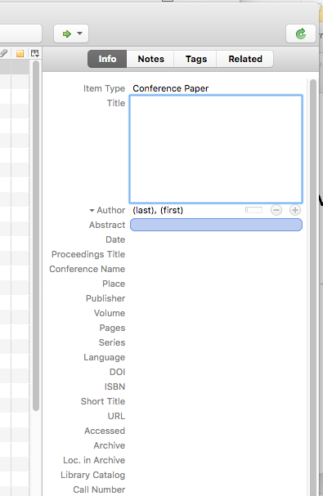
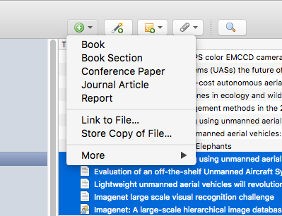

Slide 105
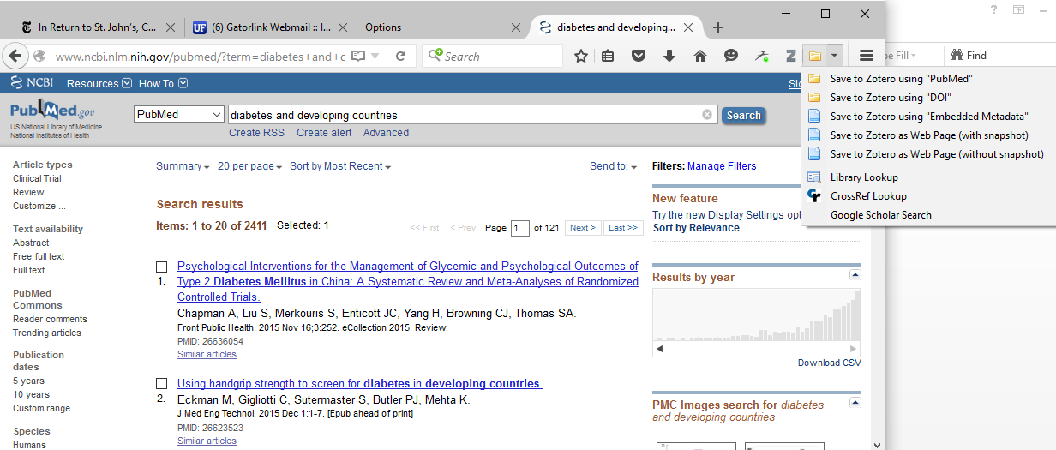
Zotero is compatible with many databases, including Google Scholar, PubMed.
If you are looking at PubMed search results, a Send to drop down menu with a Send to Zotero using “PubMed” option will appear in the address bar of your browser. If you click on this icon, the citation information will be immediately added to your collection in Zotero. Note the other Save to Zotero options.
Note: If you have not opened Zotero and opened the collection you want to use, the citations will placed in the Unfiled Items collection.
A full overview of databases and publishers supported by Zotero is available at: http://www.zotero.org/translators

Slide 106
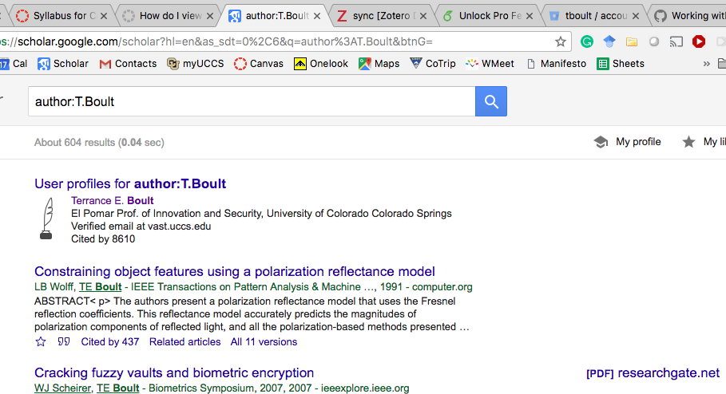
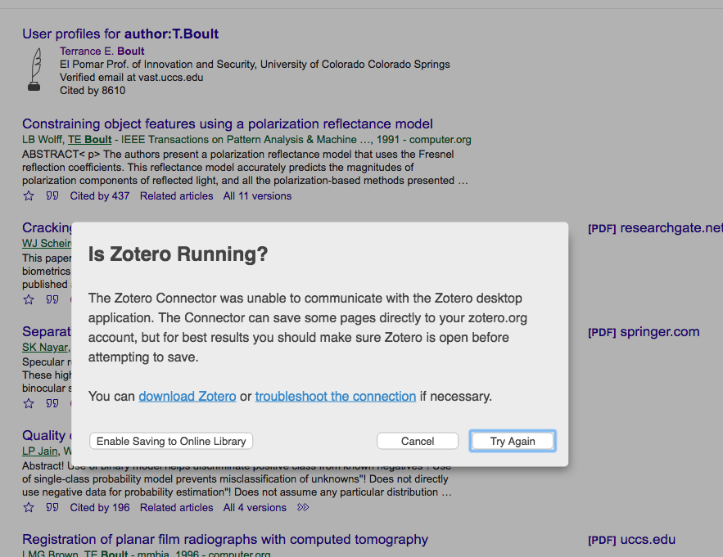
CLICK folder to import to zotero

Slide 107
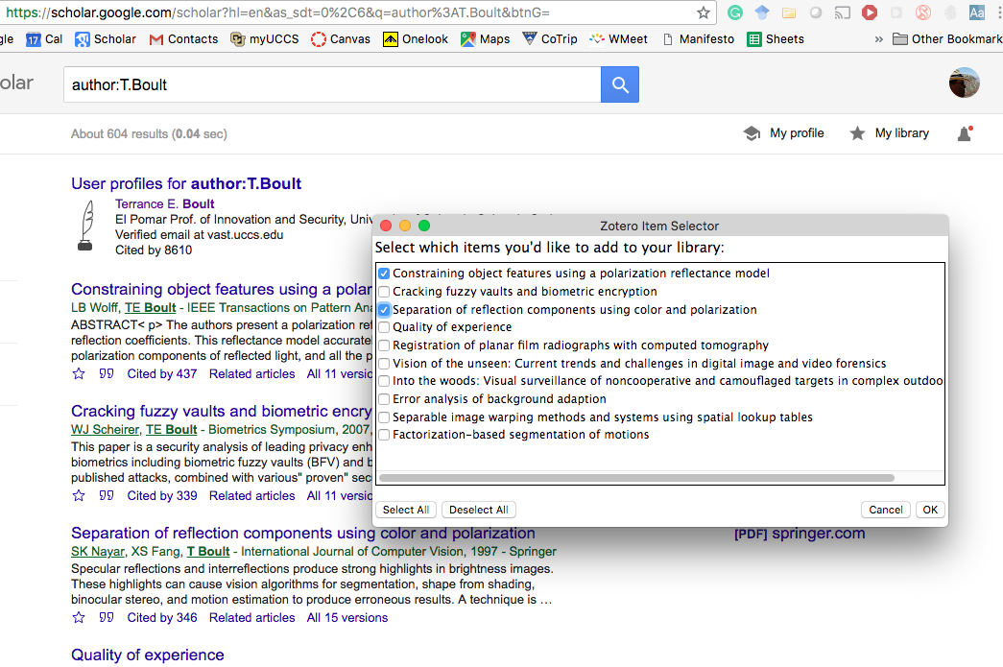
CLICK folder to import to zotero

Slide 108
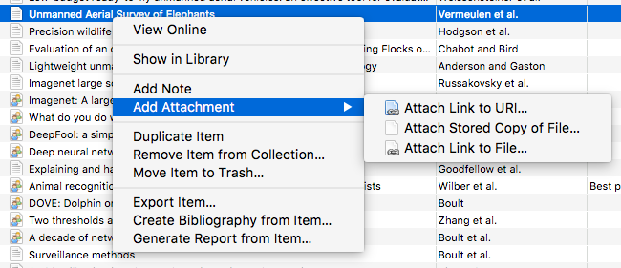
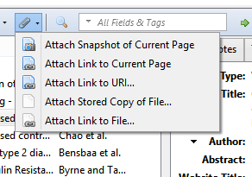
Attaching files to items
In Zotero, any type of file can be attached to an item.
Items such as the PDF of an article or images can be opened in the Firefox window, while other file-types open in external programs.
You can add attachments to items by clicking on the button in the middle column that looks like a paperclip:
All files stored in the Zotero library are kept in a folder within the Zotero directory (unless another location is specified in the Advanced preference tab).

Slide 109
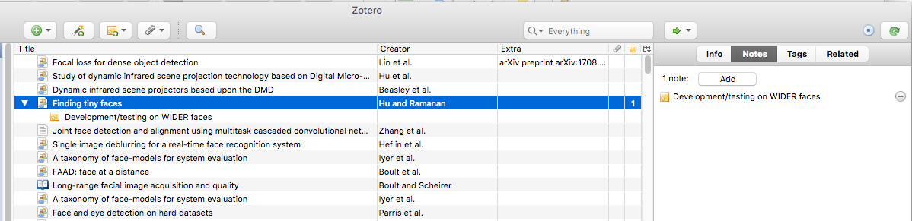
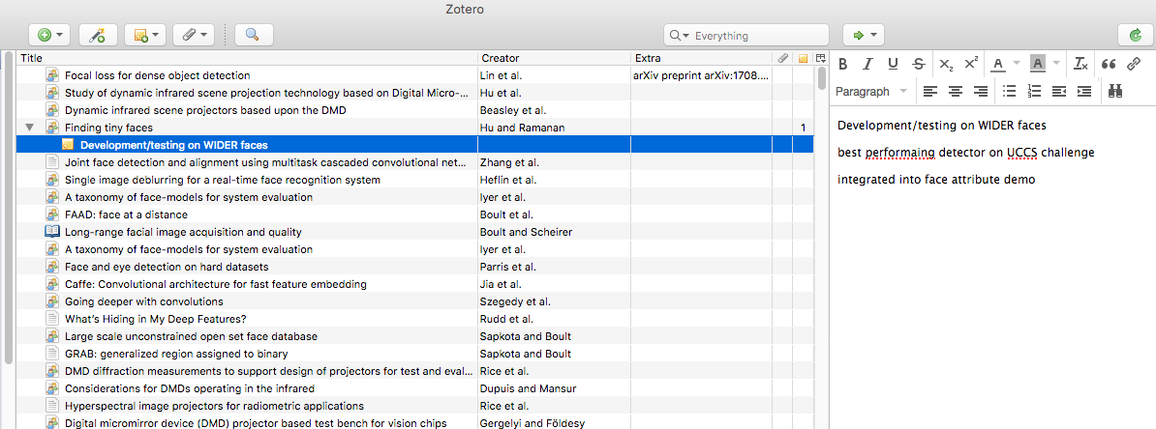
Adding Notes to Item

Slide 110
Creating bibliographies from Zotero
To create a bibliography from Zotero, highlight one or more references and then right-click to select Create Bibliography from Selected Item. Then select a Citation Style for your bibliography and choose one of the following four Formats to create your bibliography:
Save as RTF will allow you to save the bibliography as a rich text file, which can be opened for example in Word.
Save as HTML will allow you to save the bibliography as a HTML file for viewing in a web browser.
Save to Clipboard will allow you to save the bibliography to your clipboard to paste into any text field.
Can “export” references into bibtex file.

Slide 111
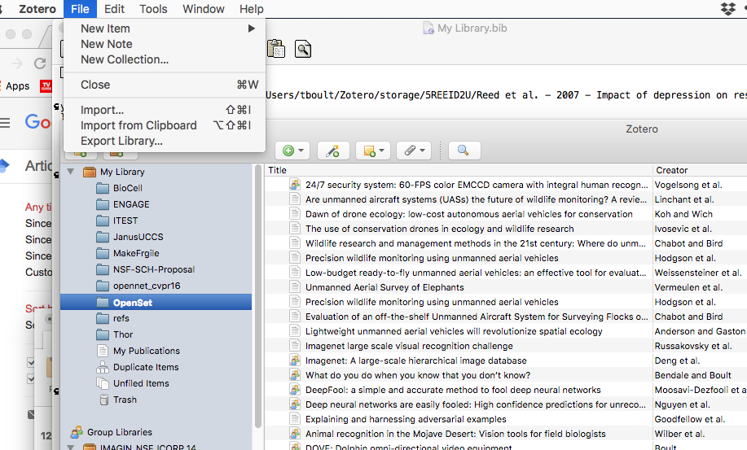
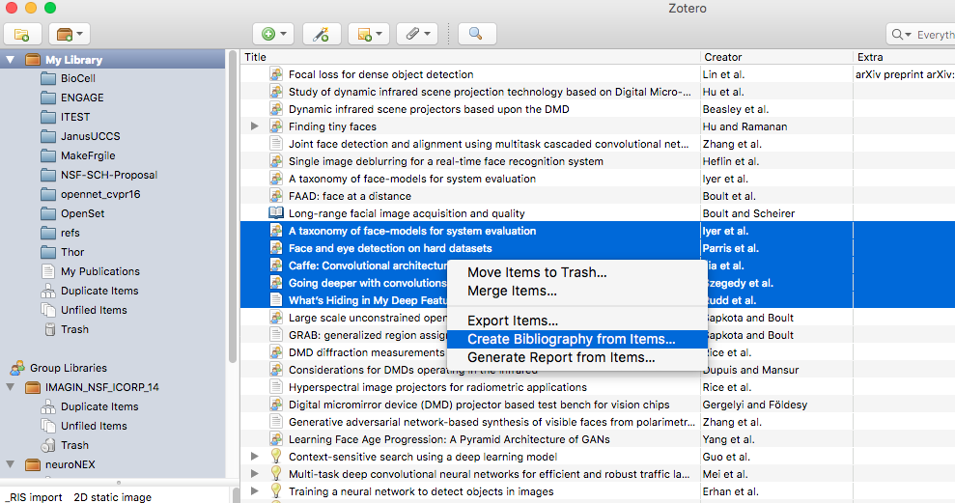

Slide 112

Word Processor Integration
Zotero's Word and OpenOffice plugins allow users to insert citations directly from their word processing software.
You can find a link to install the plugin on the Zotero homepage (www.zotero.org).
After installing the plugin and clicking on Zotero, you should see this row of icons in your Microsoft Word toolbar:
These six buttons allow you to manage references and bibliographies in your Microsoft Word documents.

Slide 113

In MS Word, click on ZOTERO in the toolbar. This will display the Zotero Plugin.

Slide 114
The key Zotero options are listed on this page.
Zotero Add Citation/Edit Citation
Zotero Insert Bibliography/Edit Bibliography
Zotero Set Documents Preferences
(to change the style)

Slide 115

To add a reference ( footnote), click on the Zotero Add/Edit Citation icon. If this is the first citation to be added, the Document Preferences window will open. Choose the bibliographic format you want to use and click on OK – in this case Vancouver.

Slide 116


The new Z box will appear. Click on the Check and then Classic View option. The Add/Edit Citation window will open.
In the Add/Edit Citation window, highlight the citation you want as a reference. Add the page # and click on OK.

Slide 117

We have added 3 Vancouver style references to this document.

Slide 118

To create a bibliography, click on the Zotero Insert Bibliography icon. This automatically adds the bibliography (in the Vancouver format) to the bottom of the document.
Note: Do not use your word processor to edit citations. Any changes automatically will revert to the original as Zotero updates your document.

Slide 119
Citation Styles
A core feature of Zotero is its ability to automatically format citations and bibliographies.
By default Zotero comes with a selection of popular styles (such as APA, Harvard , IEEand Vancouver), but many more are available through the online Zotero Style Repository at: http://www.zotero.org/styles
Visit the Style Repository and click the “[Install]” link next to the style you wish to install.

Slide 120

Zotero Citation Style Repository
Click on the “[Install]” link next to the style you wish to install.

Slide 121

Zotero web account (other options)
On www.zotero.org you can create a Zotero account.
You need a Zotero account to synchronize your library, participate in groups, or post to the support forums.
Data synchronization transfers library items, notes, links, tags, etc.—everything except attachment files—between your local computer and the Zotero servers, allowing you to work with your data from any computer with the Zotero extension. It also allows you to view your library online on www.zotero.org.
To synchronize your data with the Zotero web server, open Zotero's Sync preferences tab and enter your login information in the Zotero Sync Server section.

Slide 122

Zotero Online Library

Slide 123


Slide 124

http://www.zotero.org/support/screencast_tutorials
Zotero Screencasts demonstrate many of the basic functions of Zotero, such as adding references, managing your library, and how to use Zotero in Word.

Slide 125

Zotero Groups
Zotero Groups provide a way to share collections with a class, work with colleagues on a project or keep track of conversations in a specific field of research.
Groups can be private or public.
To create a group in Zotero: Click the New Group icon located in the top left corner of the left column in Zotero and follow the instructions.

Slide 126

Zotero Support
On the Support page on the Zotero website (http://www.zotero.org/support/), which is available in several languages, you can find documentation on additional features of Zotero as well as Frequently Asked Questions and a number of screencast tutorials.

Slide 127
Data Syncing of Zotero Libraries
While Zotero stores all data locally on your computer by default, Zotero's sync functionality allows you to access your Zotero library on any computer with internet access. Zotero syncing has two parts: data syncing and file syncing.
Data syncing syncs library items, but doesn't sync attached files (PDFs, audio and video files, images, etc.). To sync these files, you can set up file syncing to accompany data syncing, using either Zotero File Storage or WebDAV.
See https://www.zotero.org/support/sync

Slide 128
References
A Beginner’s Guide to Using Zotero - UBC Biomedical Branch Library. Available at: http://www.slideshare.net/giustinid/beginners-guide-to-zotero
Zotero Quick Start Guide. Available at: http://www.zotero.org/support/quick_start_guide
This module initially was developed by:
Ingeborg Nagel, MSc
Royal Tropical Institute (KIT) The Netherlands

Slide 129
You Tube Resources
How to insert Zotero citations and references into a Word document; explains Add-Ins (Word) uses APA citation style:
https://www.youtube.com/watch?v=imSxa5MbXrc
Zotero Overview - covers Chrome, Safari web browsers and standalone option – including how to sync web and stand alone (computer) versions; uses Vancouver citation style:
https://www.youtube.com/watch?v=vNfrv9lD_TM
Zotero Standalone account – to keep info on your computer:
https://www.youtube.com/watch?v=H8UTehdF92s
Zotero Tutorial – covers options of using Chrome and Safari web browsers:
https://www.youtube.com/watch?v=7BIrpXYk7M8
Updated 2015 12

